Slide 1
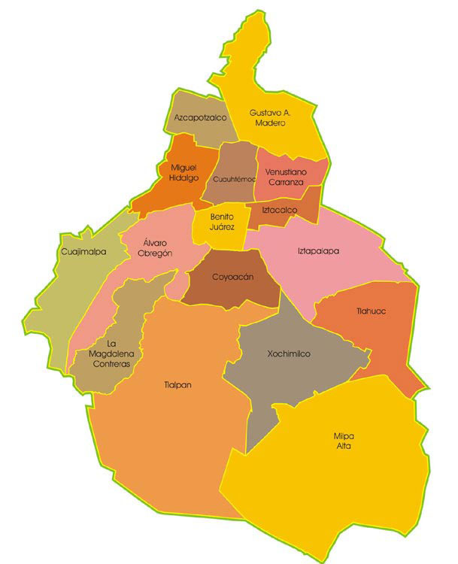
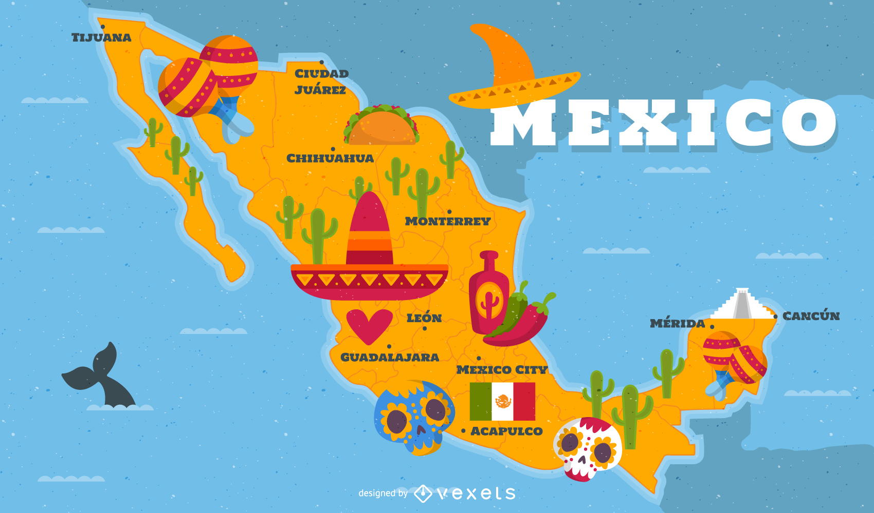
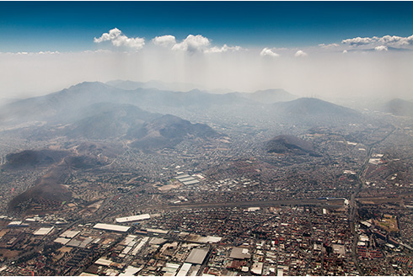

Incorporating Waterborne Disease incidence in Decision Making in Mexico City
Miguel Pessanha Pais
Aniruddha Belsare
Rocio Marilyn Caja Rivera

Slide 2
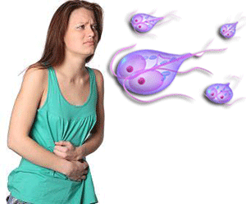
Waterborne Disease
Giardiasis
Associated with poor sanitation and water quality (high prevalence reported from parts of Mexico)
In highly populated, urban areas where water sanitation is a problem, incidence can rise very quickly once a few people are infected
Notes:
Giardia lamblia protozoal parasite- potentially debilitating disease

Slide 3
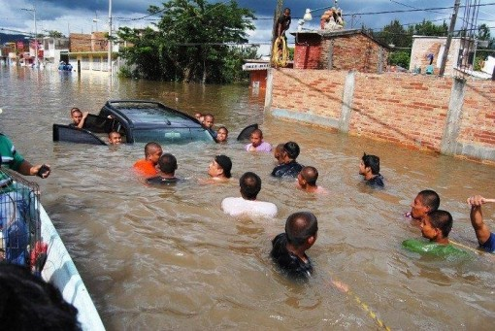
Introducing the outbreak trigger in the model
RAINFALL
Occurs in the whole landscape
Management
decision
Drainage infrastructure
influences
contribute
Neighborhood
50% probability of outbreak
Susceptible population
Altitude
Age of infrastructure
Flood Hazard!
Disease
incidence

Slide 4
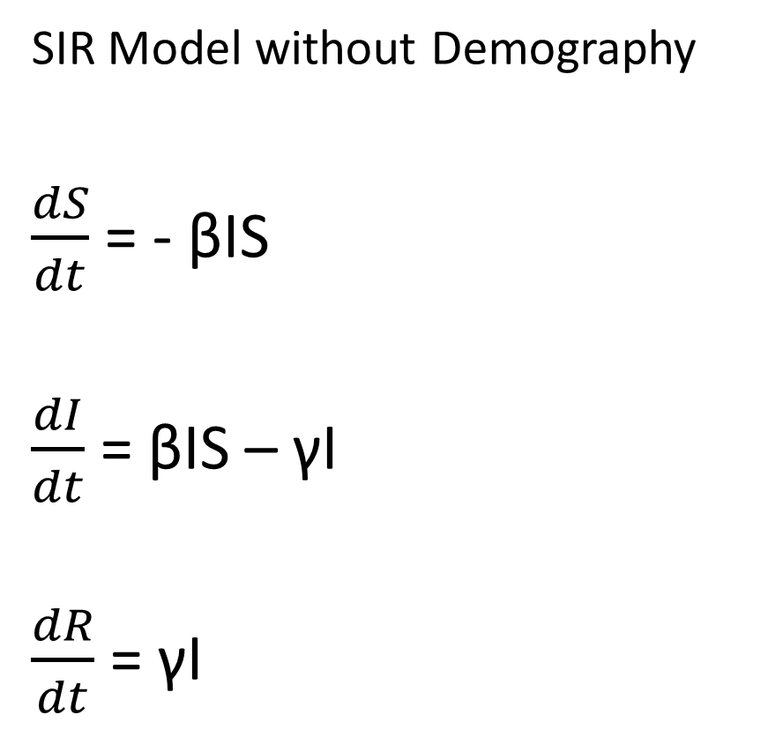
Disease Dynamics
SIR Model without Demography
$\frac{dS}{dt}$ = - βIS
$\frac{dI}{dt}$ = βIS – γI
$\frac{dR}{dt}$ = γI
Closed population
Density dependent process
β transmission rate
γ recovery rate (1 / γ is the average infectious period)
R₀ (= β / γ)

Slide 5
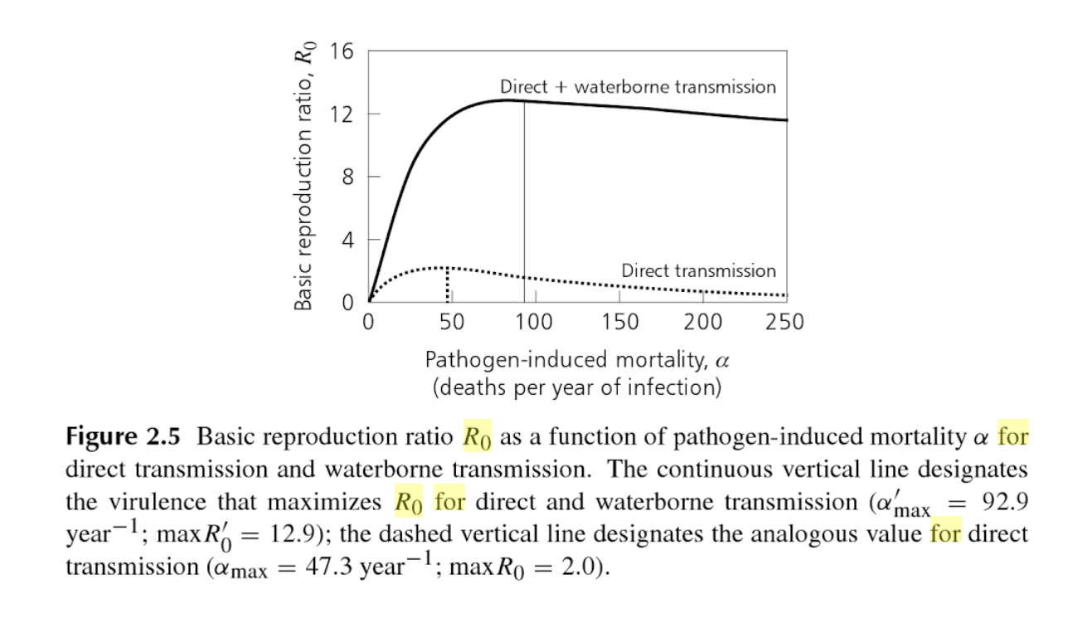


Slide 6

Simulating disease transmission
To Hazard (patch process)
If flooding…
50% probability of disease outbreak
Transmission rate is scaled by the state of infrastructure in a patch
Spillover: Patches in a radius of 2 around the outbreak generate disease cases (up to 10% of total infections on the outbreak patch)
Notes:
(current age of infrastructure / threshold age of infrastructure)

Slide 7
Hypotheses
Spatial pattern of disease incidence will reflect the state of sewage infrastructure
If disease outbreaks get more attention of the Water Authority, the overall age of sewage infrastructure will stabilize over time
If disease outbreaks get more attention of the Water Authority, water scarcity issues will increase in frequency over time

Slide 8
Decision algorithm
IDEAL
Drain
Supply
Protests
Protests
Age
Benefit more neighbors
Age
Benefit more neighbors
No drainage
No supply
7%
Decision every 10 steps
Repair / new

Slide 9
Decision algorithm
IDEAL
Drain
Supply
Disease incidence in the last year (10 steps)
Scaled by a threshold: 1500 incidences
Repair / new

Slide 10


Population 21,505,108
“Parallel Universe” experiment
1 Km² neighborhoods with an average of 3000 people
Old infrastructure (supply and drainage)
Run for 50 years (500 steps)
Fixed random seed, changing policy scenario
Squeaky wheel: Protests 70%
Expand access: No infrastructure 70%
Repair first: Age 70%
Disease importance: None, 10%, 50%
population
altitude

Slide 11
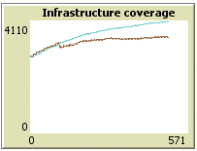
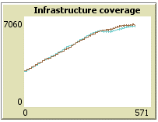
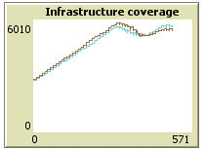
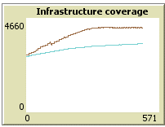
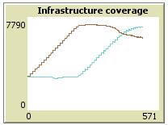
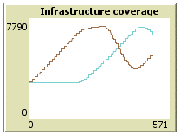
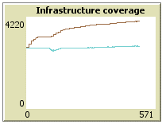
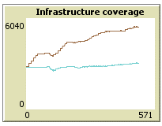
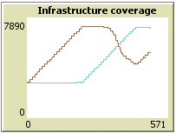
Squeaky wheel
Expand Access
Repair first
Infrastructure coverage
Water supply
Drainage
Baseline
Disease 10%
Disease 50%

Slide 12
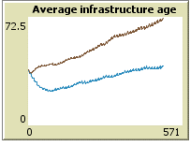
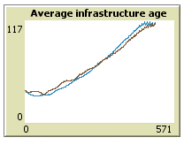
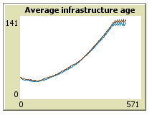
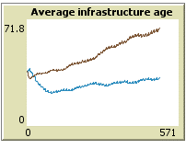
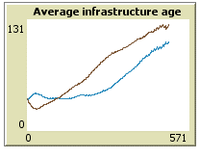
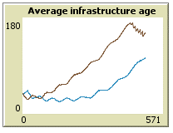
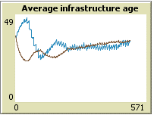
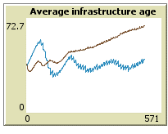
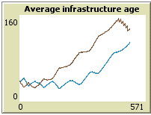
Squeaky wheel
Expand Access
Repair first
Infrastructure age
Water supply
Drainage
Baseline
Disease 10%
Disease 50%

Slide 13

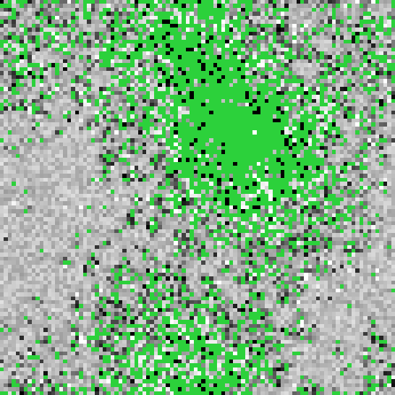







Squeaky wheel
Expand Access
Repair first
Drainage coverage and age
White is newer
Baseline
Disease 10%
Disease 50%
Notes:
Disease brings greater focus on flood areas

Slide 14
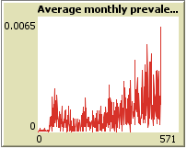
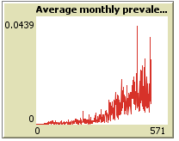
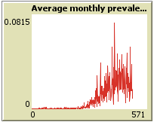
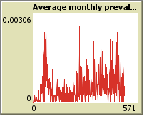
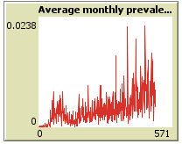
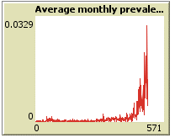
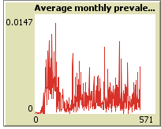
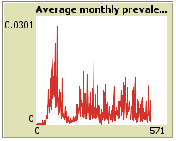
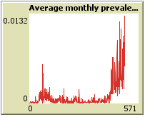
Squeaky wheel
Expand Access
Repair first
Disease incidence
Average “monthly” proportion of infected
Baseline
Disease 10%
Disease 50%

Slide 15

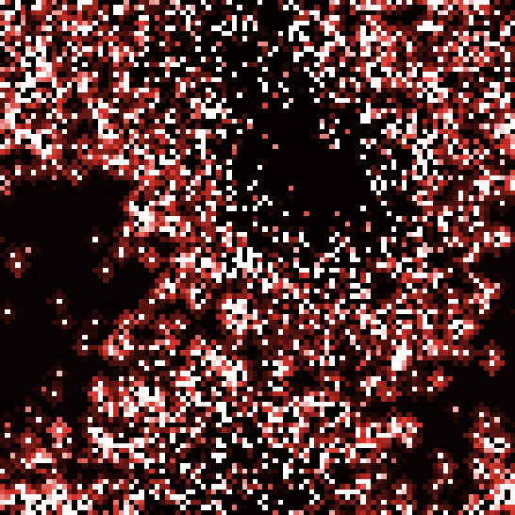


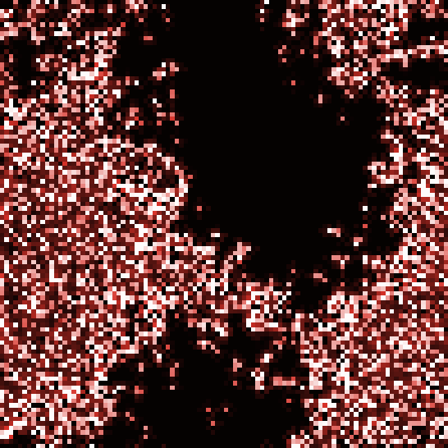


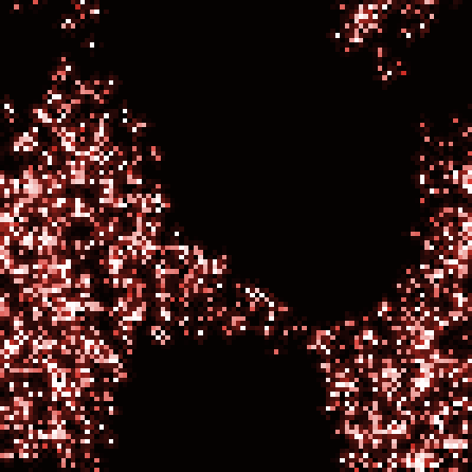

Squeaky wheel
Expand Access
Repair first
Disease incidence
Last 10 years
White is higher
Black is absence
Baseline
Disease 10%
Disease 50%
Notes:
Prioritizing with limited resources

Slide 16



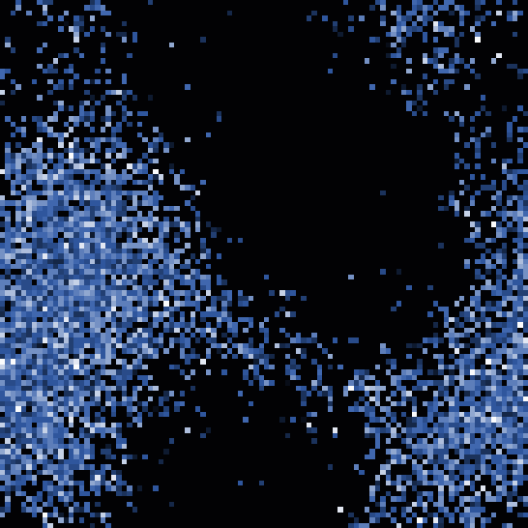


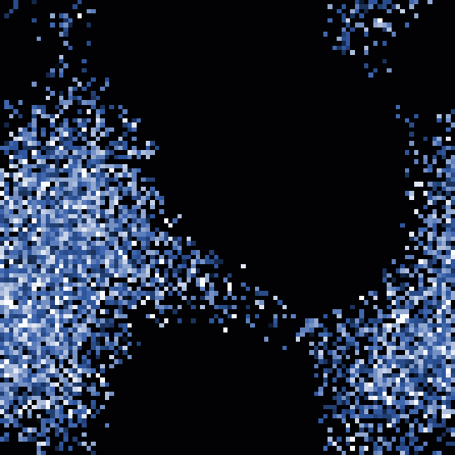
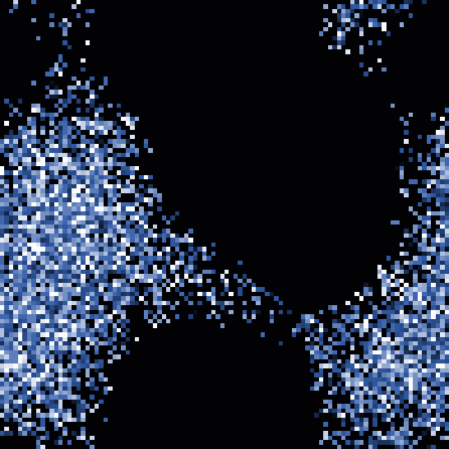

Squeaky wheel
Expand Access
Repair first
Floods
Last 10 years
White is more
Black is absence
Baseline
Disease 10%
Disease 50%

Slide 17
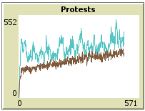
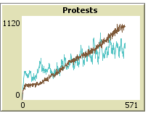
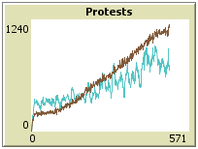
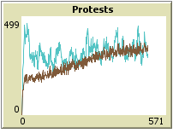
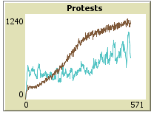
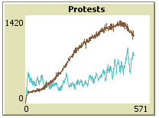
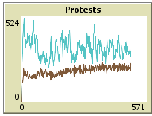
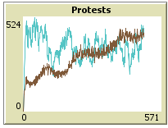
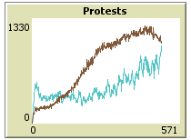
Squeaky wheel
Expand Access
Repair first
Protests
Want supply
Want drainage
Baseline
Disease 10%
Disease 50%

Slide 18
Main conclusions :
Supply infrastructure state was usually neglected
Expanding affects the ability to manage
Effect on reducing flooding:
When policy focuses on something else, disease draws attention to flooding hazards
When policy responds directly to hazards, disease becomes a distraction

Slide 19
Improving the model:
More realistic parameters and more detailed disease dynamics (survey data, moving agents, agent heterogeneity)
How policy scenarios fit other types of disease dynamics
Optimization of the decision algorithm for different goals

